Slide 1

How Machine Learning can improve your wine feature selection when deciding to start a vineyard…

Slide 2
Ben wants to start a vineyard, but doesn’t know what physiochemical properties produce the best quality wine?
Randall and Kai are prospective investors and want to know what wine properties lead to “quality wine”

Slide 3
There's so many ways to go wrong …
Our very own sweet ben.

Slide 4

How do you make a wine to get your customers to smooch city?
Our very own sweet Randall after a bottle of wine from our vineyard

Slide 5

Blind test.

Slide 6
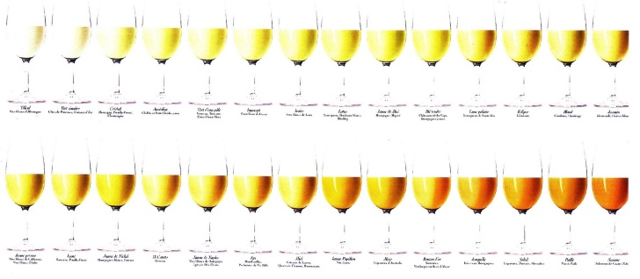
What factors affect wine quality?

Slide 7
Dependencies
import numpy as np # This library allows to easily carry out simple and complex mathematical operations.
import matplotlib.pyplot as plt #Allows us to plot data, create graphs and visualize data. Perfect for your Powerpoint slides ;)
import sklearn #The one and only. This amazing library holds all the secrets. Containing powerful algorithms packed in a single line of code, this is where the magic will happen.
import sklearn.model_selection # more of sklearn. It is a big library, but trust me it is worth it.
import sklearn.preprocessing
from sklearn.preprocessing import LabelEncoder,OneHotEncoder
from sklearn.preprocessing import StandardScaler
from sklearn.model_selection import train_test_split
from sklearn.metrics import r2_score, explained_variance_score,mean_absolute_error,mean_squared_error,precision_score,recall_score, accuracy_score,f1_score
from sklearn.utils import shuffle
import pandas as pd
from pandas.plotting import radviz
import random # Allows us to call random numbers, occasionally very useful.
#from google.colab import files #Allows to upload and download files directly from the browser.
import pprint#Allows us to neatly display text
from collections import OrderedDict
#Unsupervised Learning
from sklearn.neighbors import NearestNeighbors,LocalOutlierFactor
from sklearn.cluster import KMeans

Slide 8
from sklearn.linear_model import LogisticRegression classifier = LogisticRegression() classifier
Machine learning model

Slide 9
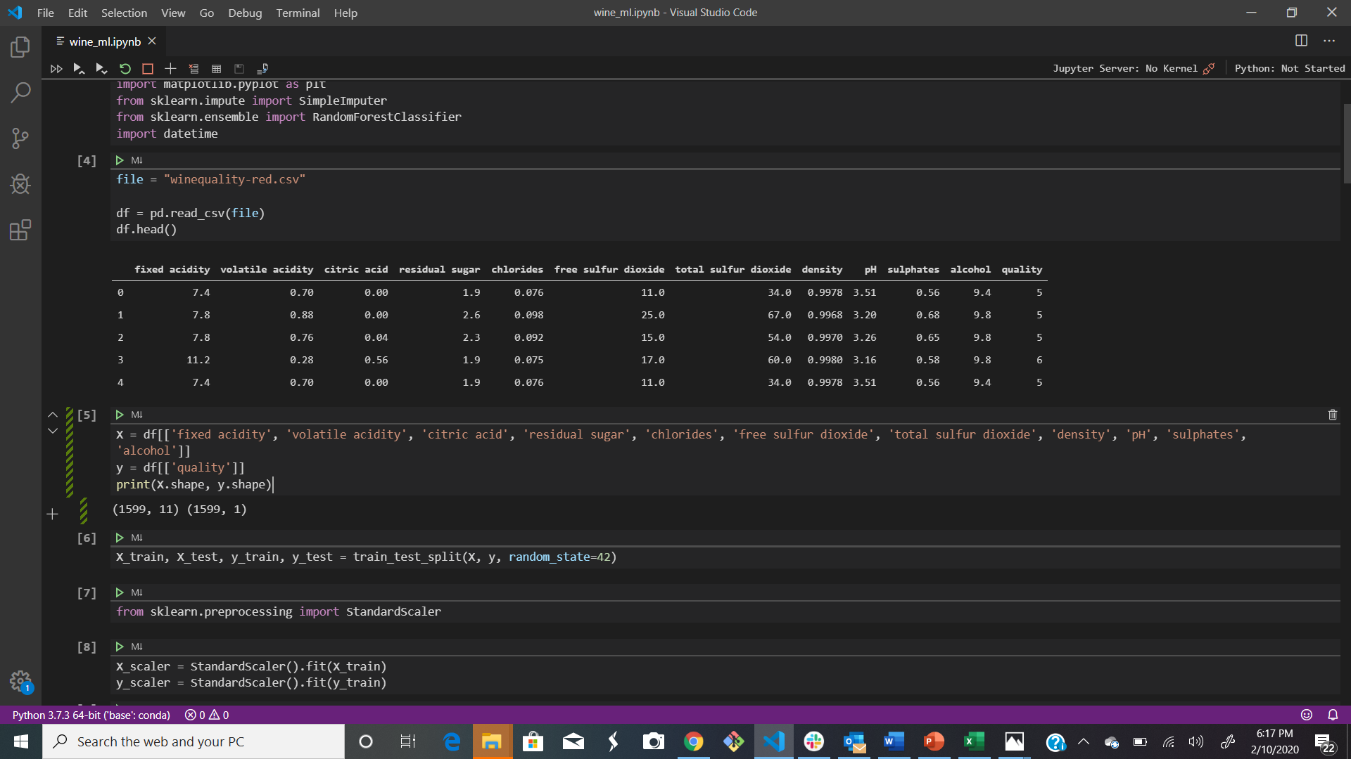

Classifying the Quality of White Wines We tried to identify how physiochemical properties for these wines are different from rest of the wines that make a wine taste better according to the experts.
Sub setting: First we will create a subset of wines rated 5 or above effectively making quality having two factors. Quality rating > 5 : wine is "Good" Quality rating <=5 : wine is "Not good
CSV file containing 12 features used to define quality

Slide 10
Feature definition
1 - fixed acidity: most acids involved with wine or fixed or nonvolatile (do not evaporate readily)
2 - volatile acidity: the amount of acetic acid in wine, which at too high of levels can lead to an unpleasant, vinegar taste
3 - citric acid: found in small quantities, citric acid can add 'freshness' and flavor to wines
4 - residual sugar: the amount of sugar remaining after fermentation stops, it's rare to find wines with less than 1 gram/liter and wines with greater than 45 grams/liter are considered sweet
5 - chlorides: the amount of salt in the wine
6 - free sulfur dioxide: the free form of SO2 exists in equilibrium between molecular SO2 (as a dissolved gas) and bisulfite ion; it prevents microbial growth and the oxidation of wine
7 - total sulfur dioxide: amount of free and bound forms of S02; in low concentrations, SO2 is mostly undetectable in wine, but at free SO2 concentrations over 50 ppm, SO2 becomes evident in the nose and taste of wine
8 - density: the density of water is close to that of water depending on the percent alcohol and sugar content
9 - pH: describes how acidic or basic a wine is on a scale from 0 (very acidic) to 14 (very basic); most wines are between 3-4 on the pH scale
10 - sulphates: a wine additive which can contribute to sulfur dioxide gas (S02) levels, wich acts as an antimicrobial and antioxidant
11 - alcohol: the percent alcohol content of the wine

Slide 11
Visualizing the attributes Before making prediction, we will try to visualize the rest of the variables and see if we can find any pattern that could explain the quality of white wines.
Correlation: The dataset has 11 physio-chemical attributes and there are chances that some of them are correlated. To check this and also to check how strongly quality is correlated with other variables we will plot correlation matrix.

Slide 12
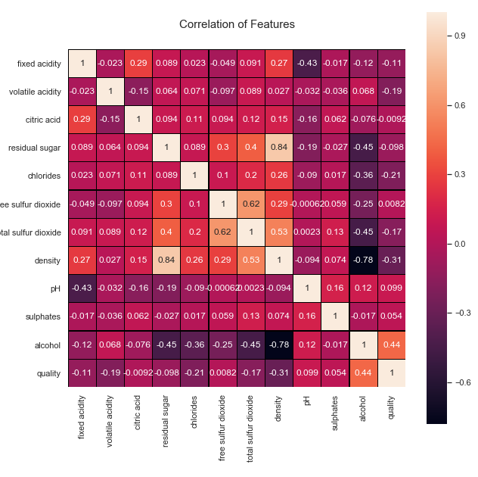
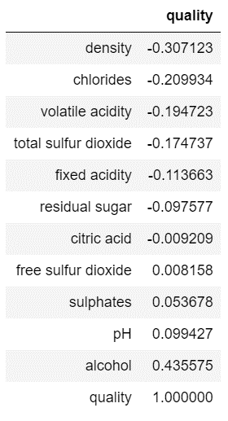
Correlation of features
df.corr()
sns.heatmap(df.corr())

Slide 13
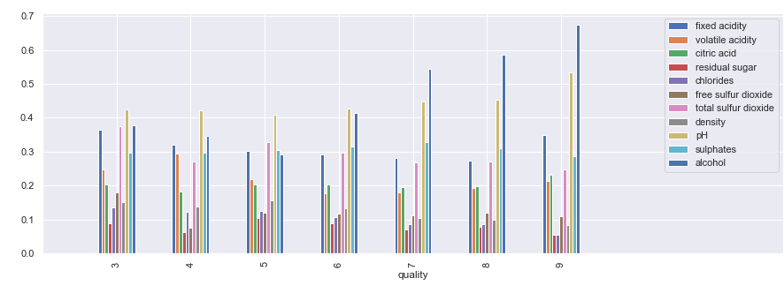
X = df[['fixed acidity', 'volatile acidity', 'citric acid', 'residual sugar', 'chlorides', 'free sulfur dioxide', 'total sulfur dioxide', 'density', 'pH', 'sulphates', 'alcohol’]]
y = df[['quality']]

Slide 14
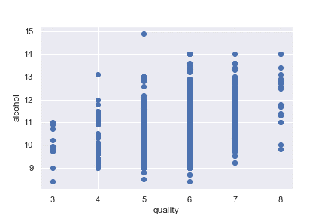
Alcohol vs Quality

Slide 15
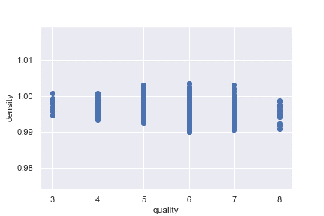
Density vs Quality

Slide 16
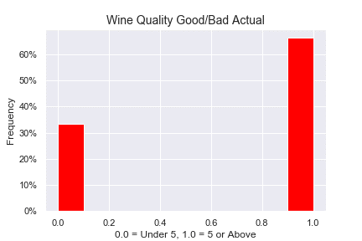
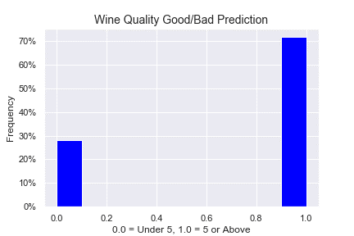
Testing vs Training the model
X_train, X_test, y_train, y_test = train_test_split(X, y, random_state=1, stratify=y)
Training Data Score: 0.5279063435883474
Testing Data Score: 0.5257142857142857

Slide 17
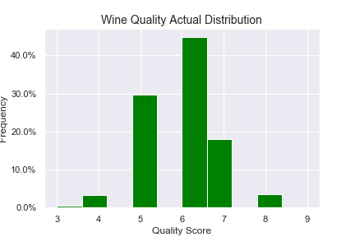
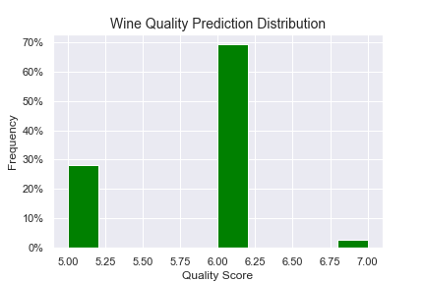
Predictions vs Actual
the actual quality scores formed a traditional bell curve
Our algorithm returned values between 5-7

Slide 18
Run more instances
More data
Removing the insignificant variables and checking for improvement in R-Squared value.
Compare more features
fixed.acidity
volatile.acidity
residual.sugar
free.sulfur.dioxide
pH
Different wine data
Wine features with stronger correlation
Vineyard location
Different kind of grapes
Types of wine: chardonnay, Riesling, etc.
Use different machine learning models
Average the models ~ (Linear + Logistic )
Stack the models

Slide 19
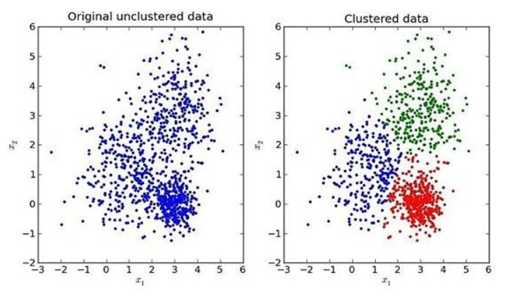
Improvements to Algorithm
Applying some sort of cluster
lof = LocalOutlierFactor(novelty=True)
lof.fit(df)
kmeans= KMeans(n_clusters=3)kmeans.fit(df)
df['category']= kmeans.fit_predict(df)
df['category'].value_counts()
3 different Clusters(0-2)
0 1977
2 1796
1 1125

Slide 20
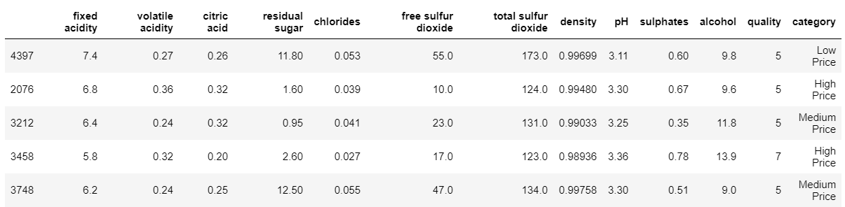
Improvements to Algorithm
Apply a price feature
df['category'] = df['category'].apply(lambda x:"High Price" if x==2 else x)
df['category'] = df['category'].apply(lambda x:"Medium Price" if x==0 else x)
df['category'] = df['category'].apply(lambda x:"Low Price" if x==1 else x)

